Slide 1
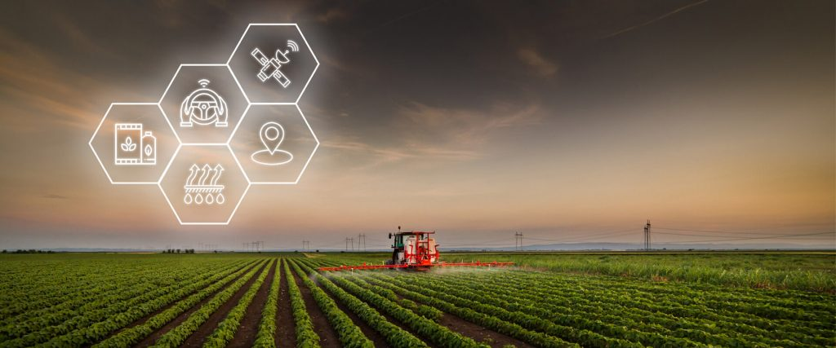
Project Name: Agri-Weather Insight
Leveraging Earth Observation Data For
Informed Agriculture Decision Making
Team : ECO VISIONARIES

Slide 2
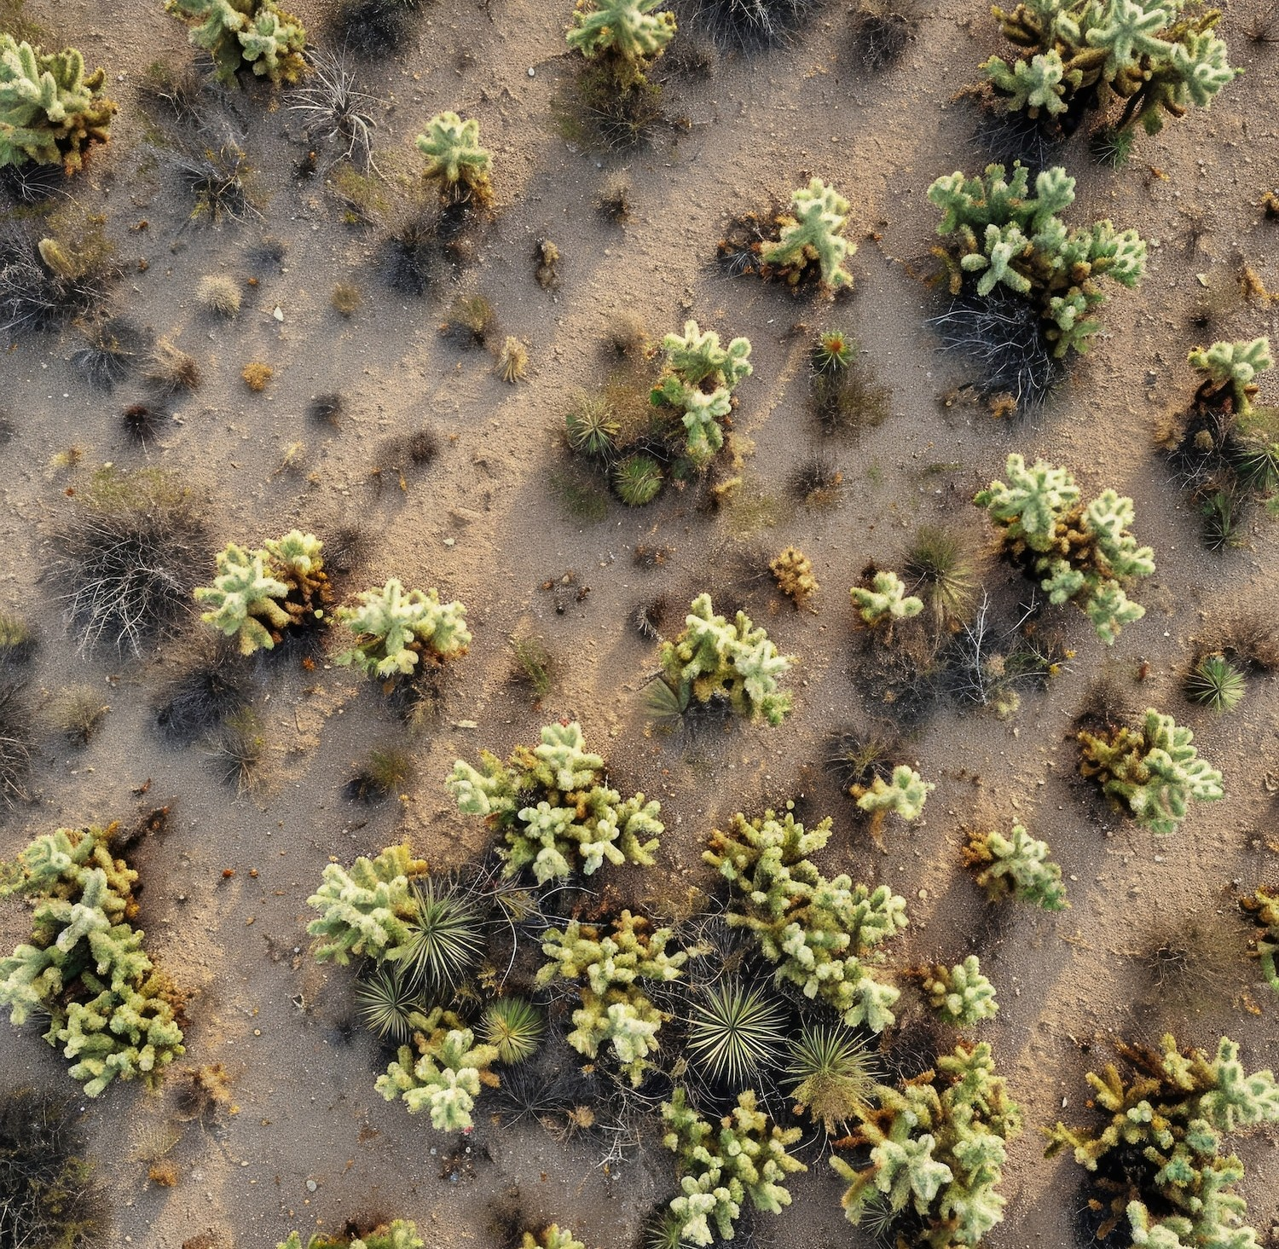
Introduction
Agriculture is facing increasing challenges due to unpredictable weather patterns, pest infestations, and resource management issues. Our project seeks to leverage NASA’s Earth observation data to address these challenges effectively by developing a user-friendly mobile application. This app will provide farmers with real-time insights into environmental conditions, allowing them to optimize water management and enhance crop health. By integrating NASA’s extensive datasets with on-ground sensor information, we aim to empower farmers to make informed decisions that promote sustainability and resilience in their agricultural practices. Ultimately, this initiative aspires to support sustainable farming practices and contribute to food security in the face of climate variability

Slide 3
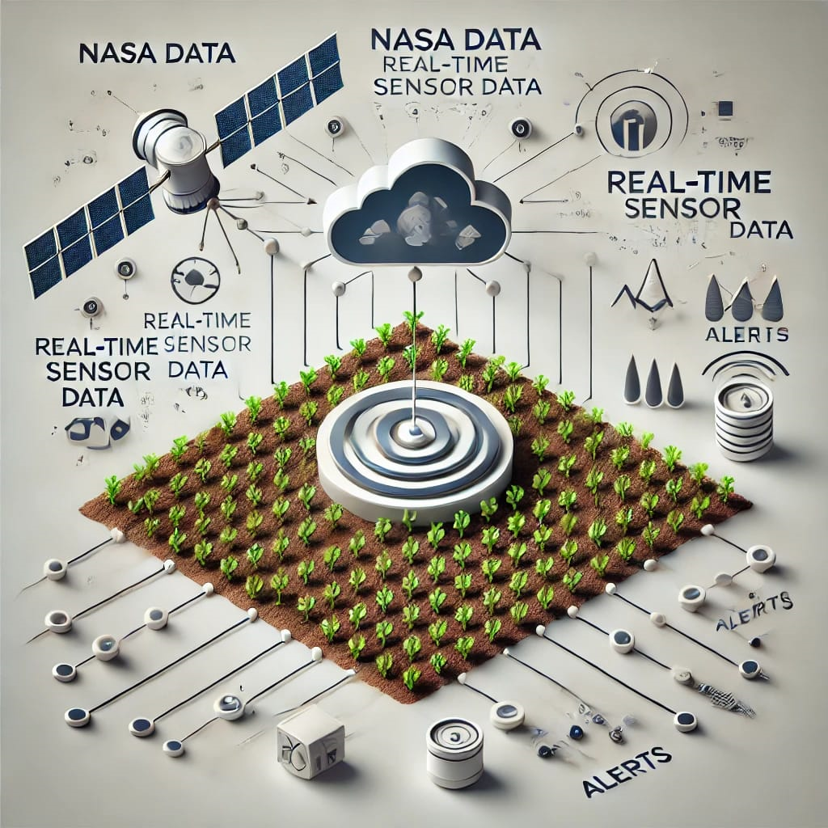
Data Integration
Data Integration:
Combining NASA’s Earth observation data with real-time sensor data
Providing real-time insights into key environmental parameters:
Temperature
Humidity
Rainfall
Wind Speed
Predicting risks like floods, droughts, and pest infestations
Empowering farmers with actionable insights for timely and informed decision-making
Optimizing resources and improving agricultural sustainability

Slide 4
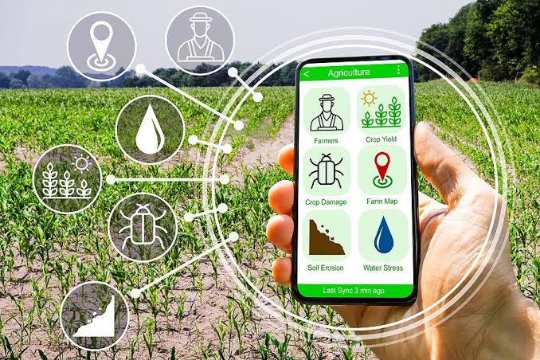
Project Focus
Mobile Application Development
Leveraging NASA's Earth observation data to assist farmers.
Real-Time Updates
Providing critical environmental insights:
Rainfall
Wind speed
Humidity
Temperature
Alerts and Guidance
Flood risk alerts to help farmers prepare and respond
.Proactive instructions for effective pest management.
Data-Driven Recommendations
Analyzing optimal planting and harvesting times.
Enhancing productivity and resource efficiency.
Goal
Support sustainable agricultural practices and improve food security.

Slide 5
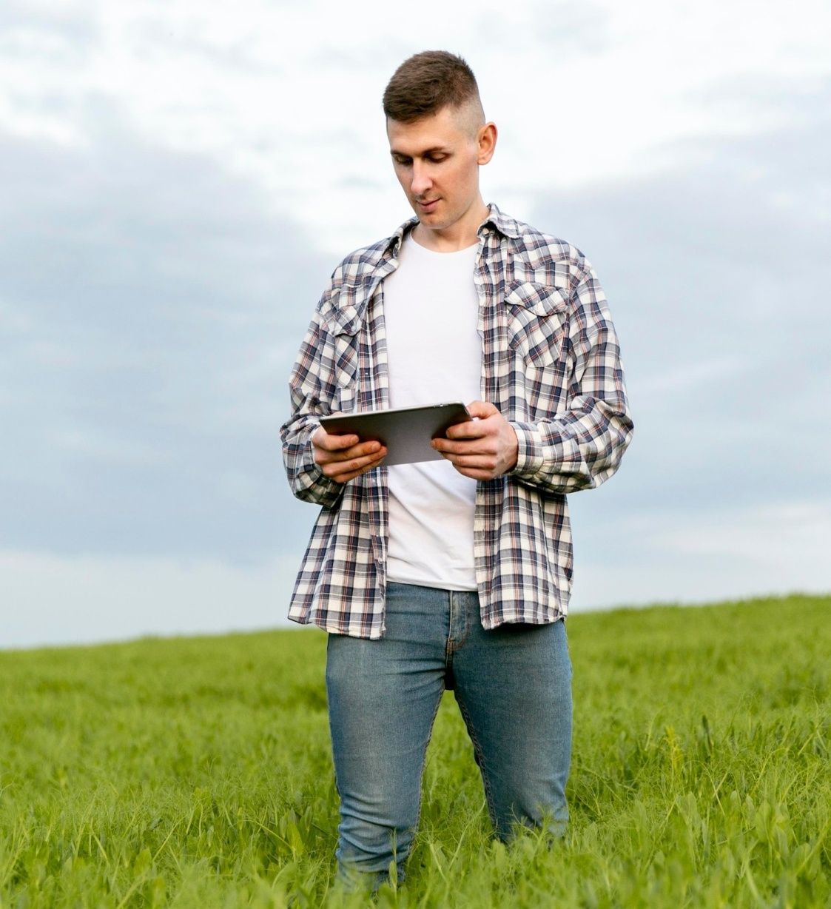
Importance Of Real-Time Monitoring
Timely Decision-Making: Real-time monitoring provides immediate access to crucial data, enabling farmers to make quick and informed decisions that positively impact crop health and yields.
Enhanced Responsiveness: Farmers can react swiftly to environmental changes, such as sudden weather events, pests, or disease outbreaks, minimizing potential damage to crops.
Optimized Resource Management: Continuous data allows for better allocation of resources (water, fertilizers, pesticides), leading to reduced waste and increased efficiency.
Increased Productivity: Access to real-time insights helps farmers maximize their crop yields by ensuring optimal growing conditions and timely interventions.
Sustainability: Effective monitoring supports sustainable practices by promoting responsible resource use and minimizing the environmental impact of agricultural activities.

Slide 6
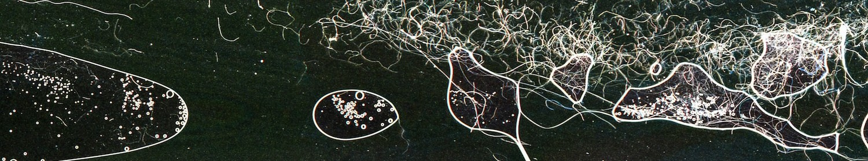
NASA Data Utilization
Leveraging NASA's Resources: NASA’s Earth observation data provides a wealth of real-time information on environmental conditions, enabling advanced insights into weather patterns, moisture levels, and atmospheric changes.
Application in Agriculture: Farmers can use this data to monitor critical factors like rainfall, temperature, and drought conditions. By integrating this information with on-ground sensor data, our app allows farmers to make informed decisions that improve water usage and crop health.
Real-World Impact: The use of NASA datasets enables farmers to predict extreme weather events and prevent crop damage by optimizing their irrigation schedules and pest control strategies. This approach supports sustainable farming practices and ensures better food security.

Slide 7
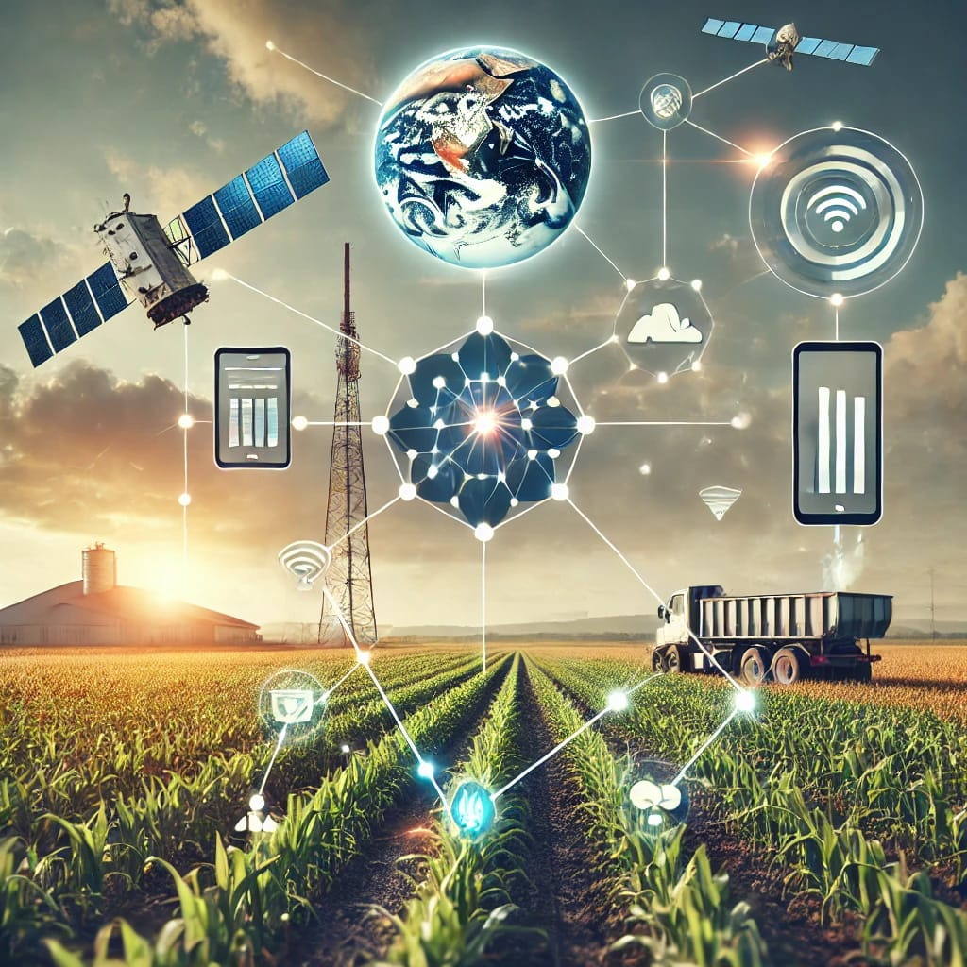
Integration of Technologies
Comprehensive System for Farmers:
Sensor Integration: Utilize temperature, humidity, and wind flow sensors to collect real-time environmental data essential for agricultural decisions.
Data Sources: Integrate NASA datasets (e.g., soil moisture, flood data) to provide comprehensive insights into weather patterns, crop health, and pest risks.
Mobile Application: Develop a user-friendly mobile app that aggregates data from various sources, offering farmers actionable insights and alerts.
User Experience Focus
Real-Time Notifications: Implement features for timely alerts on rainfall, floods, and pest management, allowing farmers to take immediate action.
Data-Driven Recommendations: Provide personalized guidance on optimal planting and harvesting times based on real-time data analytics.
Community Connectivity: Foster a platform for farmers to share experiences and insights, enhancing community engagement and knowledge sharing.

Slide 8
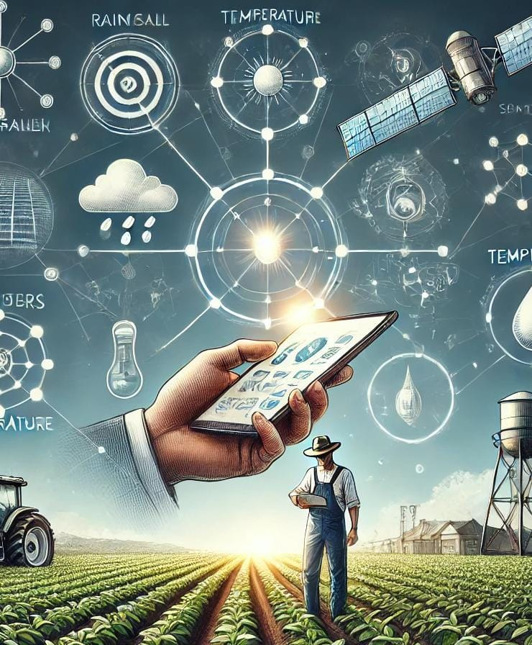
Case Studies
Precision Agriculture in California
Utilized: Satellite imagery for crop health monitoring.
Impact: 20% increase in yields and 30% reduction in water usage.
Flood Risk Management in Louisiana
Utilized: NASA flood data for risk prediction.
Impact: 15% reduction in flood-related crop damages through timely alerts.
Drought Monitoring in Texas
Utilized: Soil moisture data for irrigation guidance.
Impact: 25% increase in yields during drought conditions by conserving water.
Pest Management in Florida
Utilized: Satellite data for early pest outbreak identification.
Impact: 40% reduction in pesticide use and improved crop health.

Slide 9
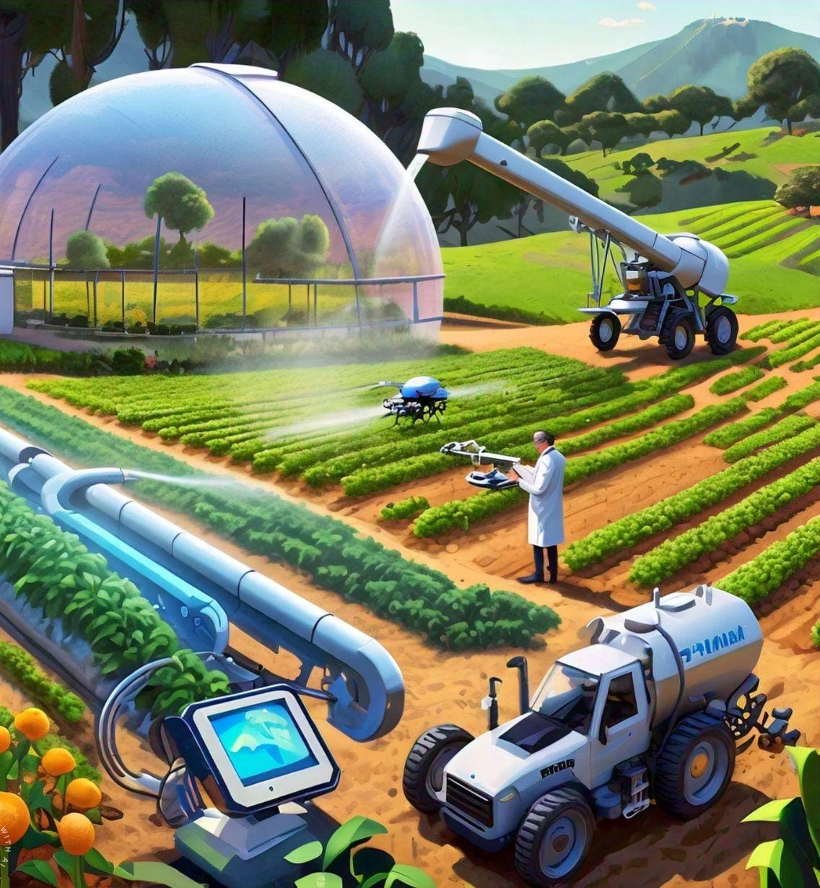
Challenges and Solutions
Challenges:
Data Accessibility: Difficulty in accessing and interpreting diverse datasets from various sources, which can hinder effective decision-making.
High Implementation Costs: The initial costs of sensors, technology, and app development can be a barrier for smallholder farmers.
Technical Literacy: Many farmers may lack the technical skills needed to effectively utilize advanced technologies and apps.
Proposed Solutions:
User-Friendly Interface: Design the app with a simple and intuitive interface, making it accessible for all farmers, regardless of technical expertise.
Community Engagement and Training: Provide workshops and training sessions to educate farmers on using the app and understanding the data.
Partnerships for Funding: Seek partnerships with agricultural organizations and government programs to subsidize costs and provide affordable technology solutions.

Slide 10
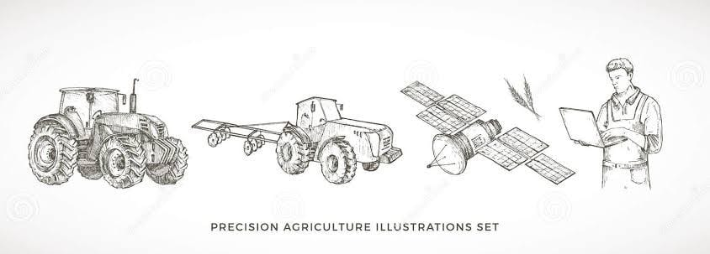
Future Outlook
Data-Driven Decisions: Increasing adoption of precision agriculture, utilizing data to enhance efficiency and sustainability.
Advancements in Technology: Improved remote sensing, satellites, and drones providing real-time, accurate data for proactive farming decisions.
AI Integration: Utilizing AI and machine learning for predictive analytics to forecast weather, pest outbreaks, and crop yields.
Vision for the App:
Comprehensive Support:Evolving into a decision support system that integrates diverse data sources for tailored recommendations.
Sustainable Practices:
Promoting responsible resource management and sustainable farming to ensure long-term agricultural resilience.

Slide 11
Advantages
Enhanced Decision-MakingData-Driven Insights: Access to real-time data on weather, soil moisture, and crop health enables informed decisions that optimize agricultural practices
Improved Resource ManagementWater Conservation: Targeted irrigation recommendations help reduce water usage, promoting sustainable practices and increasing efficiency.
Increased Crop YieldsOptimized Planting and Harvesting: Accurate forecasts and data analytics assist farmers in determining the best times for planting and harvesting, leading to higher yields.
Early Warning SystemsPest and Disease Alerts: Real-time alerts on potential pest outbreaks and disease risks allow for timely interventions, reducing crop loss.
Cost SavingsReduced Input Costs: Efficient resource use leads to lower costs for water, fertilizers, and pesticides, improving the profitability of farming operations.
Community Empowerment Knowledge Sharing: The app fosters community engagement, allowing farmers to share experiences and learn from one another, enhancing overall agricultural resilience.
Market Timing: Weather information can influence market dynamics, allowing farmers to sell their produce at optimal times.

Slide 12

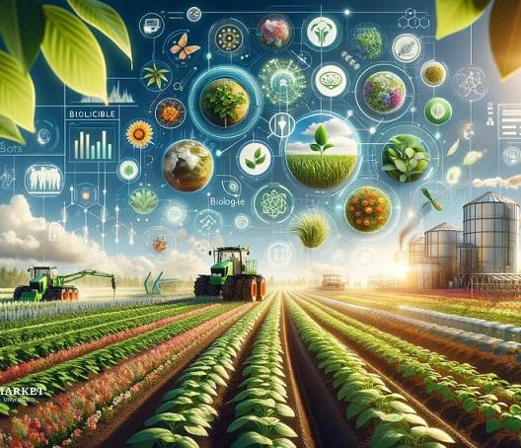
Conclusion
Key Takeaways
Addressing Challenges: Our project leverages NASA data to tackle water-related challenges in agriculture, empowering farmers with timely information.
Technological Integration: Real-time monitoring and data analytics enhance decision-making, improving resource management and crop productivity.
Call to Action: We invite collaboration and feedback from farmers and stakeholders to refine the app and maximize its impact on sustainable farming practices.

Slide 13
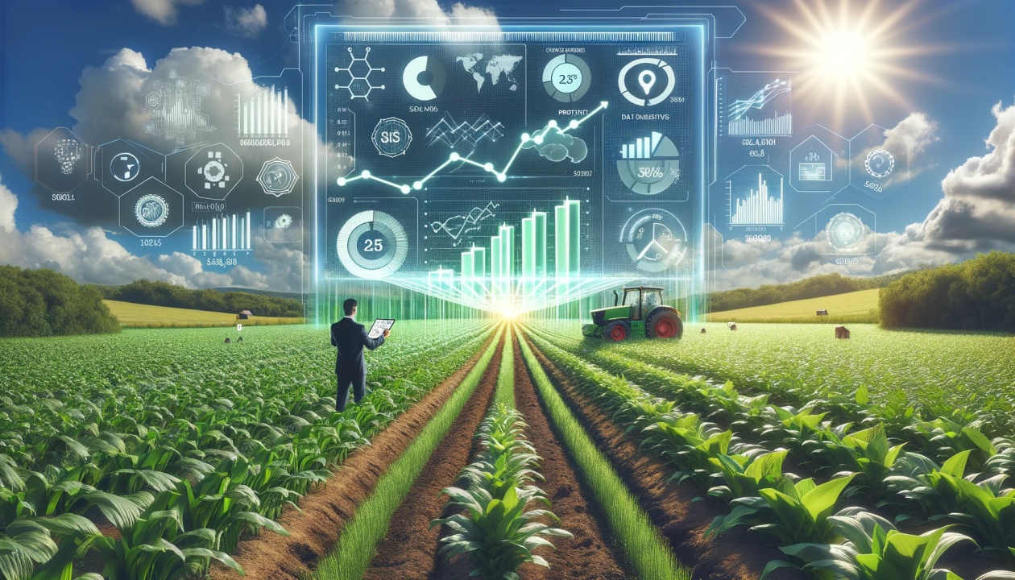
Thank you for your attention and interest in our project, " Agri-Weather Insight." We appreciate any questions or feedback you may have.

